Slide 1
Windows Azure Websites and Virtual Machines
Richard Conway
Windows Azure MVP
Elastacloud Limited

Slide 2
Websites Basics

Slide 3



Windows Azure
Your Datacenter
Virtual Machines
Cloud Services
Web Sites
Applications
Applications
Applications
Applications
Data
Data
Data
Data
Firewall
Firewall Rules
Firewall Rules
Network
Virtual Network
Virtual Network
O/S
O/S
Virtualization
Hardware
Focus on the Application
Notes:
Slide Objectives:
Explain the differences between traditional self-hosting and the three options of Windows Azure hosting.
Notes:
In a traditional environment you must manage the full stack. With Windows Azure you can choose a variety of options depending on your needs.

Slide 4

Windows Azure Web Sites
powerful web sites in seconds
start simple
code smart
go live
start free, scale up and out as you go, friction-free and without the headaches
with classic asp, asp.net, php or node.js, develop on Windows, OSX or Linux
deploy live in seconds, easily monitor performance, rapidly diagnose and fix issues
Notes:
Slide Objectives:
Explain how Windows Azure websites are simple, easy, and open.
Notes:

Slide 5

Supported Publishing Methods
FTP://
TFS
WebDeploy
DropBox
Notes:
Git Deployment is Native, or through a Service hook from CodePlex, GitHub or BitBucket

Slide 6




Supported Web Frameworks
Or any custom FastCGI Handler
Notes:
Slide Objectives:
Explain that Windows Azure Web Sites supports Classic ASP, ASP.NET, PHP, and Node.js out of the box and that you can also host any custom FastCGI handler.
Notes:

Slide 7

scale
Free
Multi-tenant. Daily quotas
Shared
Multi-tenant. Daily quotas
Standard
Dedicated VMs. No quotas
Notes:
Slide Objectives:
Explain the three scale choices on Windows Azure Web Sites.
Notes:
Both free and shared are the same architecture. With standard you isolate your application to your own virtual machines that you can use and pay for whatever resources you choose.
Online Resources:
If you’d like more details on Web Site pricing and quota, see the Windows Azure pricing page here: http://www.windowsazure.com/en-us/pricing/details/web-sites/

Slide 8


web sites
shared
standard
1
shared
Shared instances
:-)
Notes:
Slide Objectives:
Explain how you can start with a small site hosted for free.
Notes:

Slide 9
web sites
shared
standard
2
shared
Shared instances
:-)
:-)
Notes:
Slide Objectives:
Explain how you can scale your site to multiple shared instances.
Notes:

Slide 10

web sites
shared
standard
1
0
standard
Shared instances
Standard instance
:-)
:-)
:-)
Notes:
Slide Objectives:
Explain how you can move to standard instances for additional scale.
Notes:

Slide 11
web sites
shared
standard
2
standard
Standard instance
Standard instance
:-)
:-)
Notes:
Slide Objectives:
Explain how you can scale up standard instances to multiple instances as needed.
Notes:

Slide 12


web sites
shared
standard
2
standard
Standard instance
Standard instance
:-)
:-)
:-)
:-)
:-)
:-)
:-)
:-)
Notes:
Slide Objectives:
Explain how you can host multiple sites that you own on a your standard instances.
Notes:

Slide 13
auto-scaling
standard
cpu utilization
Standard instance
Standard instance
Standard instance
:-)
:-)
:-)
Notes:
Slide Objectives:
Explain how you can host multiple sites that you own on a your standard instances.
Notes:

Slide 14
Diagnostics & Monitoring
HTTP Logs
Error Logs
Portal Monitoring
Log Streaming
New Relic
Notes:
Git Deployment is Native, or through a Service hook from CodePlex, GitHub or BitBucket

Slide 15





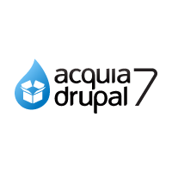










Windows Azure Web App Gallery
Ready-to-Go Open Source
Web Applications,
Frameworks,
and Templates
Notes:
Slide Objectives:
Highlight the ability to get started quickly with the Windows Azure Web App Gallery
Speaking Points:
Along-side the publishing capabilities, Windows Azure Web Sites also offers the Web App Gallery which provides many turn key solutions based off of well known open source web applications.
Notes:

Slide 16












Windows Azure Store
Discover, Purchase & Provision Premium
Services
Notes:
Slide Objectives:
Highlight the benefits of the Windows Azure Store
Speaking Points:
Much like the Windows Azure Web App Gallery brings a turn key solution to Web Applications, the Windows Azure Store quickly exposes Application and Data Services for use in your applications.
Notes:

Slide 17



Windows Azure Web Sites
start simple
code smart
go live

Slide 18
Start Simple
Get started with 10 free web sites
Create new sites in seconds
Easily manage and scale your sites
Automatic load balancing and shared storage across instances
Scale out or up to reserved instances for improved performance and scale

Slide 19
Code Smart
Use ASP.NET, ASP, PHP, or Node.js
SQL Azure or MySQL databases
Start with open source apps and frameworks
Develop with VS and WebMatrix
Supports any Web development tool on any platform (Windows, OSX, Linux)

Slide 20
Go Live
Rapid deployment for quick iteration
Integrated source control with Team Foundation Server (TFS) and Git
Built-in monitoring of perf and usage data
Quick access to request logs, failed requests diagnostics and diagnostics

Slide 21
Creating a Wordpress site
HOL
Notes:
1 – simple Example
2 – Real world – KINECT!

Slide 22
Deploying from Github
HOL
Notes:
1 – simple Example
2 – Real world – KINECT!

Slide 23
Website examples
HOL
Notes:
1 – simple Example
2 – Real world – KINECT!

Slide 24
https://elastastorage.blob.core.windows.net/msrcourse/windows azure websites files.zip

Slide 25
Deep Dive

Slide 26
Load Balancing Websites
Mechanisms
Windows Azure Load Balancing
ISS Load Balancing with ARR (Application Request Routing)
How ARR allocates resources efficiently
ARR acts as a reverse proxy to find the site
Windows Azure Websites verifies your hosting plan
Puts the site on the best virtual machine for servicing requests
If the site is not used much put it on a virtual machine with many other sites
First request determines all of the above so slower
Every subsequent request will direct traffic to the site quicker
Web Servers
File share uses CloudDrive on Blob Storage
If the site is not used often then it is removed from hosting (similar to an AppPool in IIS)
Notes:
Slide Objective
Understand a Windows Azure storage account
VALUE PROP
Speaking notes
The Windows Azure Content Delivery Network (CDN) offers developers a global solution for delivering high-bandwidth content by caching blobs and static content of compute instances at physical nodes in the United States, Europe, Asia, Australia and South America.
A Windows Azure subscription contains storage accounts
Can explicitly geo-locate to a sub region or set affinity with other services
Can enable CDN at the account level (means that public containers will be retrievable via the CDN URL)
100 TBs per account means a lot of storage for very little cost
Notes
You should change the access keys to your storage account periodically to help keep your storage connections more secure. Two access keys are assigned to enable you to maintain connections to the storage account using one access key while you regenerate the other access key.

Slide 27
Project Kudu
What is it?
Underpins deployment and version control within Windows Azure Websites
Used to hook into services like Github and Bitbucket and records deployment history
Implements its own version of Git
Uses of Kudu
Managing production and “staging” websites
Controlling “environment” variables such as well-known directories for logging etc.
Working off a branch of source control
Customising a build on startup – e.g. extra copy of files
Provide a script to customize a build
Simulate continuous deployment and don’t deploy if your tests fail
Download stuff before deployment: nuget package restore, git pull on third party repos
Run msbuild, curl or another executable
Notes:
Slide Objective
Understand a Windows Azure storage account
VALUE PROP
Speaking notes
The Windows Azure Content Delivery Network (CDN) offers developers a global solution for delivering high-bandwidth content by caching blobs and static content of compute instances at physical nodes in the United States, Europe, Asia, Australia and South America.
A Windows Azure subscription contains storage accounts
Can explicitly geo-locate to a sub region or set affinity with other services
Can enable CDN at the account level (means that public containers will be retrievable via the CDN URL)
100 TBs per account means a lot of storage for very little cost
Notes
You should change the access keys to your storage account periodically to help keep your storage connections more secure. Two access keys are assigned to enable you to maintain connections to the storage account using one access key while you regenerate the other access key.

Slide 28
Command line Kudu: Log streaming
azure site log tail <site name>
Notes:
Slide Objective
Understand a Windows Azure storage account
VALUE PROP
Speaking notes
The Windows Azure Content Delivery Network (CDN) offers developers a global solution for delivering high-bandwidth content by caching blobs and static content of compute instances at physical nodes in the United States, Europe, Asia, Australia and South America.
A Windows Azure subscription contains storage accounts
Can explicitly geo-locate to a sub region or set affinity with other services
Can enable CDN at the account level (means that public containers will be retrievable via the CDN URL)
100 TBs per account means a lot of storage for very little cost
Notes
You should change the access keys to your storage account periodically to help keep your storage connections more secure. Two access keys are assigned to enable you to maintain connections to the storage account using one access key while you regenerate the other access key.

Slide 29
Application Scenarios
Web Sites
Cloud Services
Virtual Machines
Modern web apps
Perfect if your app consists of client side markup and scripting, server side scripting and a database. Powerful capability to scale out and up as needed.
Multi-tier applications
Cloud-based applications that separate application logic into multiple tiers (i.e. caching middle tier, asynchronous background processes like order processing) using both Web and Worker Roles
Enterprise server applications
Run your existing enterprise applications in the cloud, such as SQL Server, SharePoint Server or Active Directory.
Continuous development
Deploy directly from your source code repository, using Git or Team Foundation Service.
Apps that require advanced administration
Cloud-based applications that require admin access, remote desktop access or elevated permissions
Porting existing line of business apps
Choose an image from the library or upload your own VHD.
Popular open source apps
Launch a professional looking site with a few clicks using apps like WordPress, Joomla!, Drupal, DotNetNuke and Umbraco
Apps that require advanced networking
Cloud-based applications that require network isolation for use with Windows Azure Connect or Windows Azure Virtual Network
Windows or Linux operating system
Support for Windows Server, along with community and commercial versions of Linux. Connect virtual machines with cloud services to take full advantage of PaaS services.
Notes:
Leave in appendix for QA when the question is asked.

Slide 30
Virtual Machines

Slide 31





A Continuous Offering From Private to Public Cloud
Physical
Virtual
IaaS
PaaS
SaaS
Notes:
Slide Objective:
Microsoft provides a continuous solution from private cloud to the public cloud. No matter where you are on your technology roadmap we have a solution to fit your needs.
We are a trusted advisor and platform in the traditional enterprise and ISV space and with the new IaaS offering we are making it easier to bring this same level of trust and ease of use to the public cloud.

Slide 32
Windows Azure Virtual Machines
IT Pro experience
Support for key server applications
Easy storage manageability
High availability features
Advanced networking
Integration with compute PaaS

Slide 33


Cloud First Provisioning
Getting Started
Select Image and VM Size
New Disk Persisted in Storage
Windows Server
Management Portal
Boot VM from New Disk
Linux
>_
Extra Small
Small
Medium
Large
X-Large
Scripting
(Windows, Linux and Mac)
Cloud
REST API
Notes:
Slide Objective:
Explain workflow for provisioning VMs in the cloud
Notes:
Cloud First Provisioning means exactly what is says. Building a VM in the cloud first.
You have three methods of starting this process: Build a VM from the portal, from the command line OR programmatically calling the REST API.
Once your choice of provisioning is made you will need to select the image and instance size to start from.
The newly created disk will be stored in blob storage and your machine will boot.

Slide 34
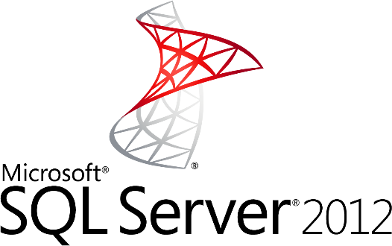
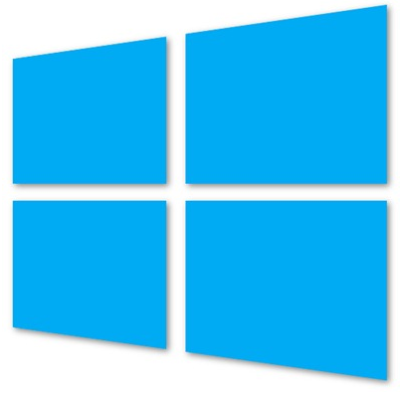


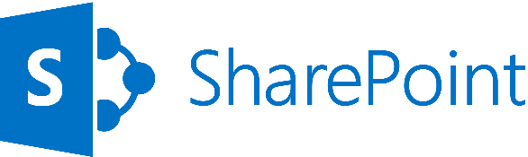
Supported Windows Server Applications
SQL Server 2008
SQL Server 2008 R2
SQL Server 2012
Windows Server 2008 R2
Windows Server 2012
SharePoint 2010 & 2013
BizTalk 2010 & 2013
System Center 2012
http://support.microsoft.com/kb/2721672
Notes:
Windows Server Windows Server 2008 R2 and later versions are supported for the following roles:
Active Directory Domain Services
Active Directory Federation Services
Active Directory Lightweight Directory Services
Application Server
DNS Server
Fax Server
Network Policy and Access Services
Print and Document Services
Web Server (IIS)
Windows Deployment Services
Windows Server Update Services
File Services

Slide 35





Linux on Windows Azure
We will support
SUSE SLES 11 sp2
Open SUSE 12.1
CentOS 6.2 by OpenLogic*
Ubuntu 12.04
Specific versions are endorsed
Integration Components
Testing and validation by partners
Bring other variants at your own risk**
*Image provided by OpenLogic based on CentOS 6.2
**Integration Work will be needed
Notes:
Slide Objectives:
Provide an understanding of which Distributions of Linux are offered in the Windows Azure Image Gallery.
Speaking Points:
1) Only Certain distributions of Linux are officially supported: SUSE Enterprise 11 SP2, OpenSUSE 12.1, CentOS 6.2, Ubuntu 12.04
2) Virtual Machine Images of these Distributions are provided by Partners who are experts in each distribution
3) Other Distributions of Linux can be installed as “Bring-Your-Own-Linux” however, some integration work will be needed.
Notes:
Linux Virtual Machines Product Page: http://www.windowsazure.com/en-us/manage/linux

Slide 36

Gallery Images Available
Microsoft
Windows Server 2008 R2
SQL Server Eval 2012
Windows Server 2012
Biztalk Server 2013 Beta
Open Source
OpenSUSE 12.2
CentOS 6.3
Ubuntu 12.04/12.10
SUSE Linux Enterprise Server 11 SP2

Slide 37
Virtual Machine Sizes
VM Size | CPU Cores | Memory | Bandwidth | # Data Disks
Extra Small | Shared | 768 MB | 5 (Mbps) | 1
Small | 1 | 1.75 GB | 100 (Mbps) | 2
Medium | 2 | 3.5 GB | 200 (Mbps) | 4
Large | 4 | 7 GB | 400 (Mbps) | 8
Extra Large | 8 | 14 GB | 800 (Mbps) | 16
Each Persistent Data Disk Can be up to 1 TB
Notes:
Slide Objective:
VM sizes

Slide 38



Linux Offering
1ST
Open Source Community
Support
First Class Citizen
Enterprise + ISV
Notes:
Slide Objectives:
Provide a better understanding of Microsoft’s Linux offering on Windows Azure
Speaking Points:
1) Linux as a first class citizen in Azure
2) We will focus mainly on Enterprises and ISVs but will also reach out to the community
a) Open Sourcing critical components
b) Documenting API
3) We will offer both Community and Commercial Distributions
4) You will be able to buy support for the commercial distributions (GA only)
Transitions:
1) First Class Citizen
2) Enterprise + ISV
3) Open Source Community
4) Support
Notes:
Any notes go here

Slide 39
Virtual Machines and Cloud Services

Slide 40

Cloud Services, Roles, and Instances
WEB ROLE
Cloud Service is a…
Management
Configuration
Security
Networking
Service Model
boundary
VM 1
VM 2
VM 3
ROLES
INSTANCES
WORKER ROLE
VM 4
VM 5
VM…

Slide 41
Cloud Services with Virtual Machines Multiple Virtual Machines can be hosted within the same cloud service
Cloud Service
VM 1
VM 2
VM 3
VM 4
Notes:
There are default limits in Azure as follows:
20 Hosted Service Projects
5 Storage Accounts
5 roles per Hosted Service (i.e. 3 different web roles + 2 different worker roles or any such combination)
20 CPU cores (not instances) across all your Hosted Service Projects
(http://blogs.msdn.com/b/jnak/archive/2010/01/22/windows-azure-instances-storage-limits.aspx)

Slide 42



Multiple Cloud Services Configuration
LB
WEB
AD/DC/DNS
SQL
AD 1
Cloud Service 2
80/443
VPN Tunnel
Corp Users
Cloud Service 1
Azure
OnPrem

Slide 43
Virtual Machines Availability

Slide 44
Service Level Agreements
Availability set
99.95% for multiple role instances
4.38 hours of downtime per year
Server 1
Server 2
What’s included
Compute Hardware failure (disk, cpu, memory)
Datacenter failures - Network failure, power failure
Hardware upgrades, Software maintenance – Host OS Updates
What is not included
VM Container crashes, Guest OS Updates
SLA 99.95
Notes:
Slide Objective:
You need an availability set for a 99.95% SLA
Notes:
Without at least two virtual machines performing the same workload grouped into an availability set you get a 99.95% SLA.

Slide 45
Fault and Update Domains
Fault Domains
Represent groups of resources anticipated to fail together
i.e. Same rack, same server
Fabric spreads instances across fault at least 2 fault domains
Update Domains
Represents groups of resources that will be updated together
Host OS updates honour service update domains
Specified in service definition
Default of 5 (up to 20)
Fabric spreads role instances across Update Domains and Fault Domains
Notes:
Slide Objective:
Discuss achieving very high availability with Windows Azure
Notes:
Fault Domain is a physical unit of failure, and is closely related to the physical infrastructure in the data centers.
In Windows Azure the rack can be considered a fault domain. However there is no 1:1 mapping between fault domain and rack.
Windows Azure Fabric is responsible to deploy the instances of your application in different fault domains.
Obviously this only applies if you run more than 1 instance
Right now Fabric makes sure that your application uses at least 2 (two) fault domains, however depending on capacity and VM availability it may happen that it is spread across more than that.
As a developer u have no direct control over how many fault domains your application will use but the way you configure it may impact your availability
Upgrade Domain is a logical unit, which determines how particular service will be upgraded.
The default number of upgrade domains that are configured for your application is 5 (five). You can control how many upgrade domains your application will use through the upgradeDomain configuration setting in your service definition file (CSDEF).
Windows Azure Fabric ensures that particular upgrade domain is not within single fault domain
That is Upgrade domains are orthogonal to fault domains
Roles are then spread out over upgrade domains and fault domains. Subject to running a reasonable number of instances this removes the risk of a single point of failure

Slide 46
Fault and Update Domains
Fault Domain
Fault Domain
Rack
Rack
Web Role
UD #1
UD #2
INSTANCE
INSTANCE
INSTANCE
INSTANCE
Worker Role
UD #1
UD #2
INSTANCE
INSTANCE
INSTANCE
INSTANCE
Notes:
Slide Objective:
Provide a graphical view of fault and upgrade domains for existing web and worker roles. Use to contrast existing skills with availability sets.
Notes:
You can see that our service is well spread out across both fault and upgrade domains
The loss of a fault domain will not cause a failure of our service nor will the restart or change of an upgrade domain cause a failure of our service
Notes
Useful pre-reading here.
http://blog.toddysm.com/2010/04/upgrade-domains-and-fault-domains-in-windows-azure.html

Slide 47
Virtual Machine Availability Sets Update Domains are honored by host OS updates
Fault Domain
Fault Domain
Rack
Rack
Virtual Machine
Virtual Machine
Availability Set
IIS1
IIS2
UD #1
UD #2
Availability Set
Virtual Machine
Virtual Machine
SQL1
SQL2
UD #1
UD #2
Notes:
Slide Objective:
Explain availability sets
Notes:
Availability sets tell the Fabric Controller to place VMs in the same set on different racks for faults and in separate upgrade domains for updates.
This essentially tells the FC not to take the guest OS down of all VMs in the same set for host updates.

Slide 48

End to End Highly Available Solution Redundancy at every level
SQL Server1
SQL-AVSET
Internet
IIS Web Application
IIS-AVSET
Web Role
SQL Mirroring
LB
IIS Web Application
SQL Server2
Web Role
Notes:
Slide Objective:
Explain that each tier of an application can be enabled with its own availability set which ensures at a physical hardware level in the data center that there is no single point of failure.

Slide 49
Virtual Machine Data Disks

Slide 50
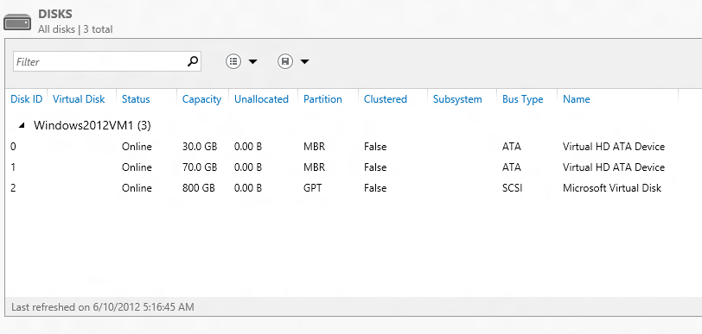
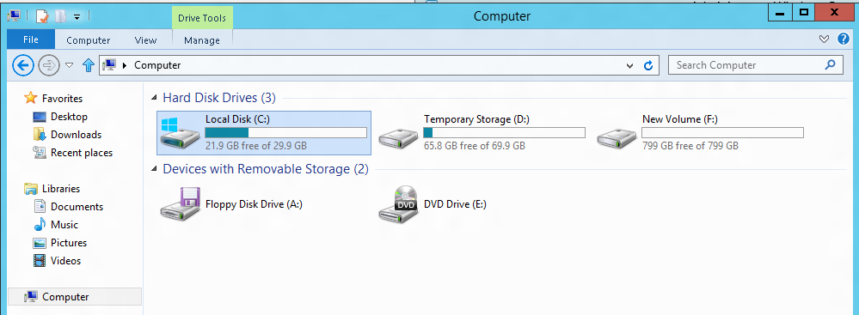
VM disk layout
OS Disk
Persistent
SATA
Drive C:

Slide 51
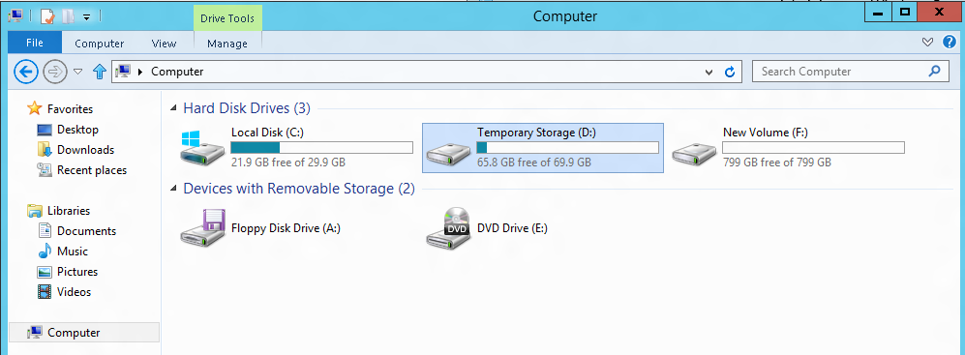
VM disk layout
Temporary Storage Disk
Local (Not Persistent)
SATA
Drive D:

Slide 52
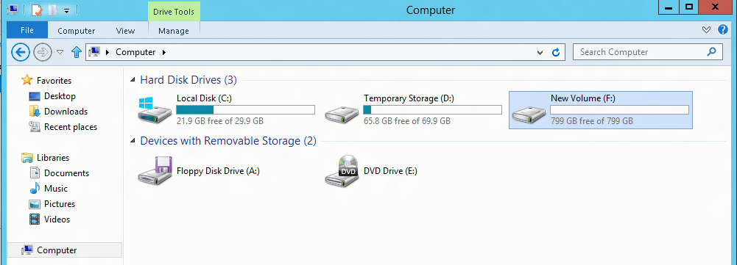
VM disk layout
Data Disk(s)
Persistent
SCSI
Customer Defined Letter

Slide 53
Persistent Disk Management
Capability | OS Disk | Data Disk
Host Cache Default | ReadWrite | None
Max Capacity | 127 GB | 1 TB
Imaging Capable | Yes | No
Hot Update | Cache Setting Requires Reboot | Change Cache Without Reboot, Add/Remove without Reboot.
C:\ = OS Disk
D:\ = Non-Persistent Cache Disk
E:\, F:\. G:\ ... Data Disks
Notes:
Slide Objective:
Highlight the differences in default cache policy between the OS disk and DataDisk

Slide 54
Disk Caching
Disk Type | Default | Supported
OS Disk | ReadWrite | Read-only and ReadWrite
Data Disk | None | None, Read-only and ReadWrite
Modify using Set-AzureOSDisk or Set-AzureDataDisk
Notes:
Slide Objective:
Data Disks can have caching enabled on up to 4 disks.

Slide 55

Persistent Disks and Highly Durable
Windows Azure Storage (Disaster Recovery)
Windows Azure Storage
Virtual Machine
Notes:
Slide Objective:
Explain how disks are durable and how Windows Azure storage works
Notes:
The OS and Data Disks are stored in Windows Azure storage. So in addition to the data being persistent you also get the benefits of storage which means your VHD is replicated 3X’s locally and also 3X’s in a separate data center in the same region (geo-replication)

Slide 56
Persistent Disks and Highly Durable
Windows Azure Storage (Disaster Recovery)
Windows Azure Storage
Virtual Machine
Virtual Machine
Notes:
Slide Objective:
This slide simply highlights that if the physical hardware backing your VM goes down a new server will start and pick up the same VHD.

Slide 57
Virtual Machines Images

Slide 58
Disks and Images
OS Images
Microsoft
Partner
User
Base OS image for new Virtual Machines
Sys-Prepped/Generalized/Read Only
Created by uploading or by capture
Disks
OS Disks
Data Disks
Writable Disks for Virtual Machines
Created during VM creation or during upload of existing VHDs.
Notes:
Slide Objective:
Explain the differences between disks and images with VMs

Slide 59
Image Mobility
On-Premises
Cloud
MyApp.vhd
Notes:
Slide Objective:
Explain the benefits of image mobility
Notes:
One of the key benefits of IaaS is flexibility and control. The Windows Azure solution provides the capability of not only moving VHDs TO the cloud but also allows you to copy the VHD back down and run it locally or on another cloud provider. Great for testing out production issues or any other need where you require a copy of the production server.

Slide 60
Bring Your Own Server/VHD
On-Premises
Cloud
MyApp.vhd
On Premises Virtual Server
Provision VM from Image or Disk using portal, script or API
Use Case
Forklift Migration of VMs
Sys Prepped Images
VHD Must Be Fixed Disk
* CSUpload Can Convert on Upload
Upload VHD
Create Disk or
Image
Notes:
Slide Objective:
Explain workflow for bringing your own VHD
Notes:
This use case is when you already have a “golden image(s)” your company uses for server provisioning or you have a VM running on premises that you would just like to run in our data center. You take the vhd – use CSUpload or System Center App Controller to upload as a page blob to a storage account. From there use the portal to add as an image (sysprepped) or disk (configured VM) and there you can create a VM based off of the vhd.

Slide 61
Imaging VMs in the Cloud
Cloud
Identical/similar deployment instances using common OS image as start
Base.VHD
Boot
VM
Customize
VHD
Generalize
VHD
Capture
VM
Capture VM Saves Customized Image to Your Image Library
Notes:
Slide Objective:
Explain workflow for creating a custom image in the cloud
Notes:
This use case is all about using the capture feature of IaaS to create OS images. The first part you start with a base vhd that you then custom with software binaries, registry settings etc.. You run sysprep.exe and generalize/shutdown the OS. You can then upload it if coming from on-premises or just click the capture button if you created the VM in the cloud.
Capture allows you to take a generalized VM and save the underlying VHD as a new image in your image library.

Slide 62
What will work on upload…
Images
Sysprep’d Windows Server
VHD on Hyper-V
(Server 2008 R2 and Windows Server 2012)
Windows Azure Image
Windows Server
VHD on Hyper-V
(Server 2008 R2 and Windows Server 2012)
Windows Azure Disk
Disks

Slide 63
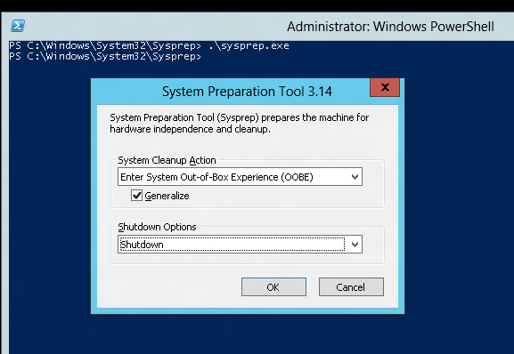
Tips on BYO Generalized Images
Sysprep and “Generalize” is expected
Do NOT put unattend.xml on the disk
Do NOT install the Windows Azure Integration Components!!
No WA Agent

Slide 64



Manage using existing Tools
Windows Intune
Macs
X86/x64
AD
Windows Server 2012
Windows RT
VPN Tunnel
Windows Phone 8
iOS
Windows Server 2012
Windows Server 2008
Windows Server 2003
Windows Server 2008
Windows Server 2003
Android
OnPrem
Azure
Internet

Slide 65
Scripting Capabilities
Full Support for IaaS
Windows Azure PowerShell Cmdlets
Cross Platform Scripting Built on node.js
Capabilities
Provisioning, Removal
Reboot, Start
Import and Export VM settings
Support for Windows and Linux VMs
Domain Join at Provision for Windows
Fully Customize VM with Data Disks and Endpoint Configuration
Automate Virtual Network Settings
Notes:
Slide Objective:
Highlight some of the functionality available to Windows Administrators to automate management / provisioning of virtual machines in the cloud.

Slide 66
What can you do with PowerShell?
Automation
Query, Manage and Configure Virtual Machines across multiple subscriptions, cloud services and storage accounts.
Provision Fully Configured Virtual Machines
Domain Joined
Storage and Networking Configured
Virtual Networking
Completely Configure VNETs from a Script

Slide 67
Virtual Machine Management
Quick VM Provisioning Mode
Supports VM Creation in a Single Cmdlet
Advanced Provisioning Configuration Mode
Provision With: Endpoints, Data Disks
Configure: Cache Settings for OS/Data Disks and Subnet Names
Create Multiple Pre-Defined VMs in a Batch
New-AzureVM -VMs $vm1, $vm2, $vm3

Slide 68
Linux Virtual Machines

Slide 69
Linux Built on Persistent VM Role
*Some Features not present in Linux at Preview
Linux
Windows
IC
Drivers
SSH Keys
WA Linux Agent
Certs
Windows Setup
Windows Azure Virtual Machines
Notes:
Slide Objectives:
Demonstrates how both Windows and Linux are utilitizing Windows Azure Virtual Machines
Speaking Points:
1) As you can see, a Linux VM has a similar Architecture as the Windows VM which we just provisioned. Let’s take a look of how the Linux Provisioning works.

Slide 70











The Technology to Provision a Linux Platform Image
HyperVisor
Customer’s
Storage Account
Stock Images
Partner Repository
VM
Data
Data Disk
OS
ICs
OS Disk
ISO
Provisioning Repository
Cache
Linux Agent
Unattend
Storage API
Add Server
Hostname
Password
…
Cache.VHD
Portal (API)
Notes:
Slide Objectives:
Understand the way in which Linux VMs are published in Windows Azure
Transition:
Same build ups as last Provision build up.
Speaking Points:
As you can see the process is practically the same as before, with the slight caveat that we have a Distribution specific agent which has been added to the VM.
Notes:
Any notes go here

Slide 71



Windows Azure Linux Agent
Service Management API
Windows Azure
provided DNS
VM
Host1
Host2
HV1
HV2
Notes:
Slide Objectives:
Depicts a failover scenario with the Linux VM
Speaking Points:
The Linux Agent communicates with the Windows Azure Service Management API in order to Notify the Fabric Controller to update the DNS Location in a Failover scenario
Legend:
HV1 – Hypervisor 1
HV2 – Hypervisor 2

Slide 72
Gallery Experience
Lowest barrier of entry
Partner created images
Click through provisioning
Leverage portal to:
Provide Images (VHDs that include ICs and agent)
Associate SSH Keys
Collect configuration information
Drive provisioning
Notes:
Slide Objectives:
Provide context for functionality available in the Gallery experience

Slide 73
Third Party Tool Provisioning
Currently Only SUSE
Ease the creation of custom images, configuration and resources
Customize a partner image
Select packages to include
Tool will include the appropriate ICs and Agent
Tool will drive provisioning for Customer if it chooses to provide it access
Notes:
Slide Objectives:
Explaining support for Third Party Provisioining Tools such as SUSE Studio
Notes:
See SUSE Studio in action at http://susestudio.com/

Slide 74
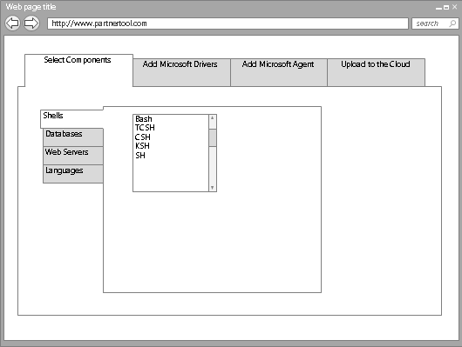



Tool Based Provisioning
XStore
VHD
Customer Personal Image Repository
VHD
VHD
Service Management API
Customer Storage Account
P
O
R
T
A
L
VM
VM2
Notes:
Slide Objectives:
Objective #1
Transition:
Transition statement(s) to setup the slide
Speaking Points:
Speaking Point #1
Speaking Point #2
Notes:
Any notes go here

Slide 75

Bring Your Own Linux
Expert Customers that want to tweak , customize, create images based on supported* distributions
Customer will
Use Hyper-V to install Distribution
Add ICs and Agent
Generate the VHD
Capture configuration
Generate resources
Upload and start instance
Linux Native: Tools, libraries, scripts
Notes:
Slide Objectives:
Explain the process around Bring-Your-Own-Linux VHD which supports customized images created in Hyper-V
Notes:
Tutorial on WindowsAzure.com: http://www.windowsazure.com/en-us/manage/linux/common-tasks/upload-a-vhd/

Slide 76
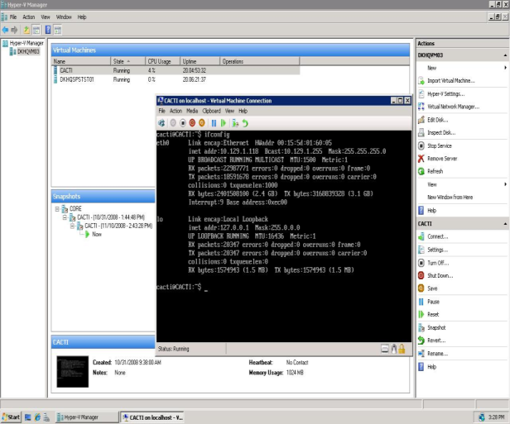
Bring Your Own Linux
XStore
VHD
Customer Personal Image Repository
VHD
Service Management API
Customer Storage Account
P
O
R
T
A
L
VHD
VM
Notes:
Slide Objectives:
Describes the workflow for provisioning a custom Linux VHD.

Slide 77
Linux on Azure Open Source Strategy
Open Source Linux Agent
Fully documented APIs
For Linux IT professionals provisioning and management operations:
Native scripts
Native libraries (open sourced)
Native tools (open sourced)
For Linux developers
Client Libraries
Documented interfaces
Notes:
Slide Objectives:
Describe the Linux on Windows Azure Open Source Strategy
Speaking Points:
1) Linux Agents will be Open Source to accept contributions from the community
2) All APIs are to be fully documented
3) Provide IT Pros with Linux Workloads with Native support to Manage the platform
4) Proivide Developers with Client Libraries and Interface Documentation for building on Windows Azure

Slide 78
vmdepot
What is it?
Underpins deployment and version control within Windows Azure Websites
Used to hook into services like Github and Bitbucket and records deployment history
Implements its own version of Git
Uses of Kudu
Managing production and “staging” websites
Controlling “environment” variables such as well-known directories for logging etc.
Working off a branch of source control
Customising a build on startup – e.g. extra copy of files
Provide a script to customize a build
Simulate continuous deployment and don’t deploy if your tests fail
Download stuff before deployment: nuget package restore, git pull on third party repos
Run msbuild, curl or another executable
Notes:
Slide Objective
Understand a Windows Azure storage account
VALUE PROP
Speaking notes
The Windows Azure Content Delivery Network (CDN) offers developers a global solution for delivering high-bandwidth content by caching blobs and static content of compute instances at physical nodes in the United States, Europe, Asia, Australia and South America.
A Windows Azure subscription contains storage accounts
Can explicitly geo-locate to a sub region or set affinity with other services
Can enable CDN at the account level (means that public containers will be retrievable via the CDN URL)
100 TBs per account means a lot of storage for very little cost
Notes
You should change the access keys to your storage account periodically to help keep your storage connections more secure. Two access keys are assigned to enable you to maintain connections to the storage account using one access key while you regenerate the other access key.

Slide 79
Capturing a Windows VM with Sysprep
HOL
Notes:
1 – simple Example
2 – Real world – KINECT!

Slide 80
Capturing a Linux VM with waagent
HOL
Notes:
1 – simple Example
2 – Real world – KINECT!

Slide 81
The platform image gallery
HOL
Notes:
1 – simple Example
2 – Real world – KINECT!

Slide 82
Using vmdepot
HOL
Notes:
1 – simple Example
2 – Real world – KINECT!

Slide 83
Adding Data Disks to a Windows and Linux VM
HOL
Notes:
1 – simple Example
2 – Real world – KINECT!

Slide 84
https://elastastorage.blob.core.windows.net/msrcourse/virtual machines.zip

Slide 85
https://elastastorage.blob.core.windows.net/msrcourse/iPython.zip

Slide 86
Questions?

